Slide 1
Advanced NGS Analysis (Day 1) Session II
Lyda Hill department of Bioinformatics 2022 Nanocourse Series
Date & Time: June 27-28: 9AM-5PM (NG3.202)
Course Instructors: Bo Li, Daehwan Kim, Christopher Chaney, & Micah Thornton

Slide 2
Day 2: RNA-Seq Analysis Using Pseudo/Quasi-Alignment and Expectation Maximization (Kallisto, Salmon, H2Q).

Slide 3
What you will learn in this Session (2 Parts)
Day 1
Some Theoretical Considerations:
What is Pseudo/Quasi-Alignment
What is Alignment
Some Practical Considerations:
What is Kallisto
What is Salmon
What is H2Q
Day 2
What is Expectation Maximization for Gene Transcript Quantification
What is the resolution of Genetic Transcript Data?
What is Expectation Maximization

Slide 4
Part 1: Pseudo and Quasi Alignment & Quantification Resolution

Slide 5
RNA-Seq Experiments
RNA-Seq experiments are fundamentally distinct from DNA-seq experiments, and seeks to answer a different set of questions.
Usually we are seeking to determine whether the level of expression of a particular gene is related to a phenotypic characteristic of interest.

Slide 6

Installing Salmon & Kallisto
In order to quantify the true abundances of transcripts within a given genomic RNA-Seq sample, we use the Expectation Maximization algorithm following pseudo or quasi read alignment.
Two packages which implement this approach are Salmon and Kallisto
Salmon was developed by Rob Patro, Geet Duggal, Michael Love, Rafael Irizarry, and Carl Kingsford and published in 2017. (https://www.ncbi.nlm.nih.gov/pmc/articles/PMC5600148/)
Kallisto was developed by Nicolas L. Bray, Harold Pimentel, Páll Melsted, and Lior Pachter and published in 2016. (https://www.nature.com/articles/nbt.3519/ )
Logo from SALMON website.

Slide 7
Kallisto: Understanding the Algorithm
As previously stated, the RNA-Seq quantification algorithms used in state of the art applications generally follow two steps:
“Pseudo-Alignments” indicating the subset of transcripts which are ‘compatible’ with each read are determined.
The Expectation Maximization algorithm is applied to determine the Maximum Likelihood Estimators for the Multinomial Proportions associated with each transcript.
Kallisto uses a transcriptome de Brujin graph to determine which transcripts are compatible with each read (pair).

Slide 8
The De Brujin Graph
Zamin Iqbal, Mario Caccamo, Isaac Turner, Paul Flicek, & Gil McVean
(De novo assembly and genotyping of variants using colored de Brujin graphs).
https://www.nature.com/articles/ng.1028?ref=https://githubhelp.com

Slide 9
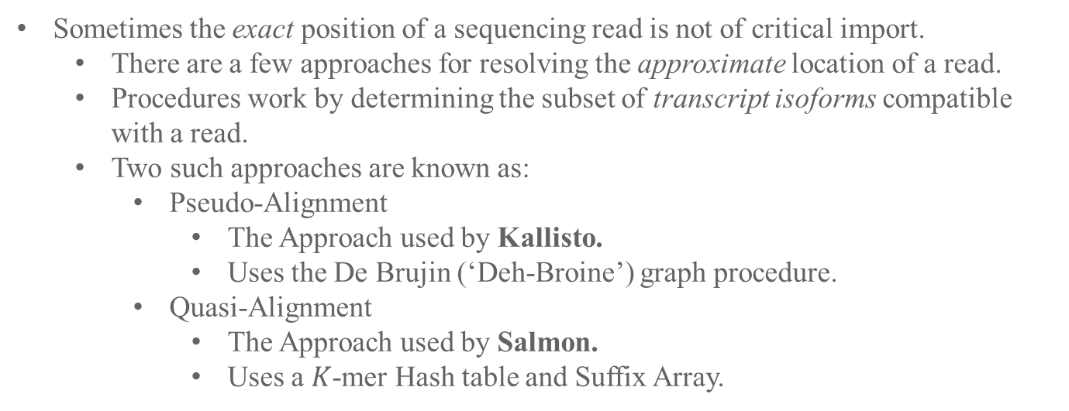
Pseudo/Quasi Alignment in RNA Experiments
Typical ‘DNA-Seq Like’ Experiment
Reads
Sometimes the exact position of a sequencing read is not of critical import.
There are a few approaches for resolving the approximate location of a read.
Procedures work by determining the subset of transcript isoforms compatible with a read.
Two such approaches are known as:
Pseudo-Alignment
The Approach used by Kallisto.
Uses the De Brujin (‘Deh-Broine’) graph procedure.
Quasi-Alignment
The Approach used by Salmon.
Uses a $K$-mer Hash table and Suffix Array.
Reference
Typical ‘RNA-Seq Like’
Experiment
Reads mapped to compatible isoforms in Transcriptome
T1
T2
Expectation
Maximization
T1
T2
T3
T4
3
2
4
1
||||
||||
|||| |
T3
T4
||||
Recall that in most typical sequencing experiments we are dealing with a large collection of shorter subsequences called reads, which we attempt to map to a larger sequence known as the reference.
Resources – Kallisto (Pseudo-alignment)
https://tinyheero.github.io/2015/09/02/pseudoalignments-kallisto.html (Higher Level Overview pseudo alignment)
https://www.youtube.com/watch?v=f-ecmECK7lw (Video Describing how To Build The De Brujin graph)
https://www.nature.com/articles/nbt.2023 (Nature Primer on Using De Brujin Graphs for Genomic Alignments).
Resources – Salmon (Quasi-alignment)
https://hbctraining.github.io/Intro-to-rnaseq-hpc-salmon-flipped/lessons/08_quasi_alignment_salmon.html (Higher Level Overview Quasi-Alignment)
https://academic.oup.com/bioinformatics/article/32/12/i192/2288985?login=true (RapMap Paper and Description).

Slide 10
Part 2: Expectation Maximization & Gene Transcript Quantification

Slide 11

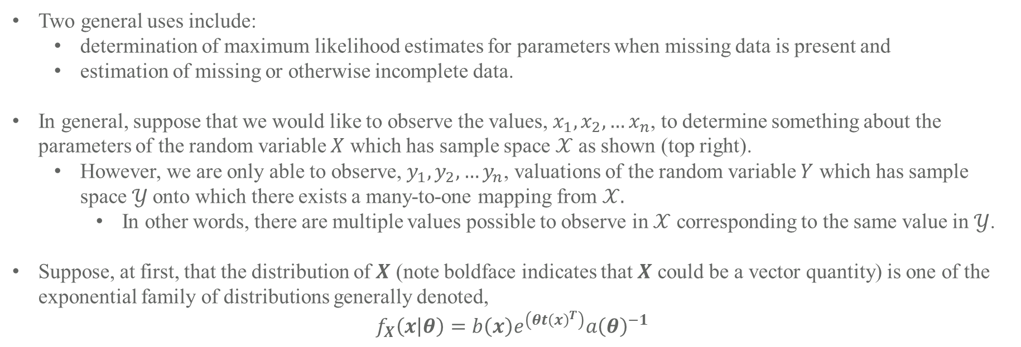
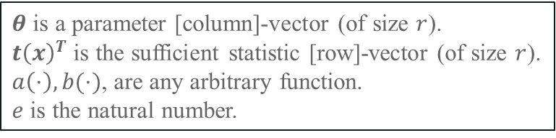

Many-to-one relationship
Expectation Maximization (in general) – Incomplete Data & A Restricted Case
$$𝒳$$
$$𝒴$$
Two general uses include:
determination of maximum likelihood estimates for parameters when missing data is present and
estimation of missing or otherwise incomplete data.
In general, suppose that we would like to observe the values, $x_{1},x_{2},…x_{n}$, to determine something about the parameters of the random variable $X$ which has sample space $𝒳$ as shown (top right).
However, we are only able to observe, $y_{1},y_{2},…y_{n}$, valuations of the random variable $Y$ which has sample space $𝒴$onto which there exists a many-to-one mapping from $𝒳.$
In other words, there are multiple values possible to observe in $𝒳$ corresponding to the same value in $𝒴$.
Suppose, at first, that the distribution of $X$ (note boldface indicates that $X$ could be a vector quantity) is one of the exponential family of distributions generally denoted,
$$f_{X}\left(x | θ\right)=b\left(x\right)e^{\left(θt{\left(x\right)}^{T}\right)}a{\left(θ\right)}^{−1}$$
$θ$ is a parameter [column]-vector (of size $r$).
$t{\left(x\right)}^{T}$ is the sufficient statistic [row]-vector (of size $r$).
$a\left(⋅\right),b(⋅)$, are any arbitrary function.
$e$ is the natural number.
See section II of the Dempster, Laird, Rubin paper mentioned below for more details about natural parameters.
These Expectation Maximization Notes Draw Heavily from “Maximum Likelihood from Incomplete Data via the EM Algorithm” by Dempster Rubin and Laird (https://www.jstor.org/stable/2984875)

Slide 12
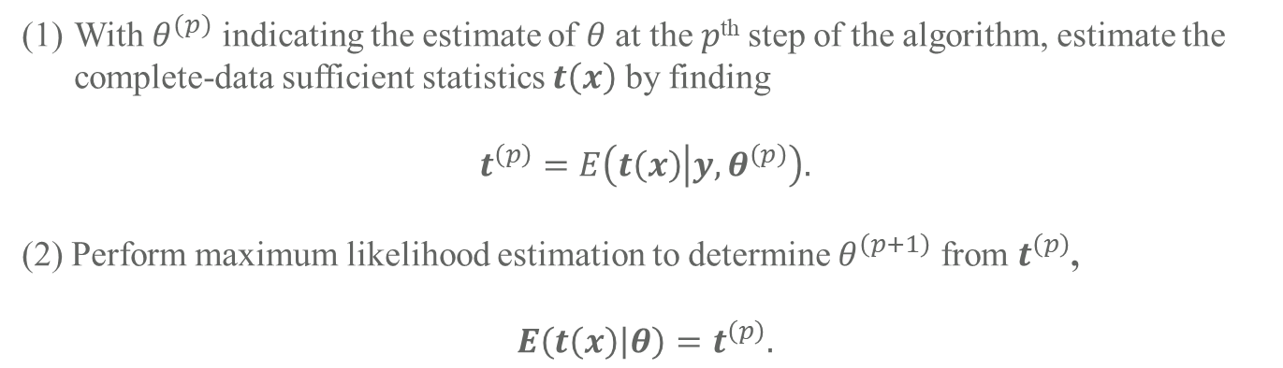
Expectation Maximization (in general) – The Algorithm
The “simple characterization” of the EM algorithm according to Dempster, Laird, and Rubin (DLR77) is:
With $θ^{(p)}$ indicating the estimate of $θ$ at the $p$^{th} step of the algorithm, estimate the complete-data sufficient statistics $t\left(x\right)$ by finding
$$t^{\left(p\right)}=E\left(t\left(x\right) | y,θ^{\left(p\right)}\right).$$
(2) Perform maximum likelihood estimation to determine $θ^{\left(p+1\right)}$ from $t^{\left(p\right)}$,
$$E\left(t\left(x\right) | θ\right)=t^{\left(p\right)}.$$
Proof of convergence to the maximum likelihood value is given the DLR77, as are details regarding further generalizations of the expectation maximization algorithm.
The algorithm is broadly applicable in many cases, and not all of the applications have been discovered yet.
These Expectation Maximization Notes Draw Heavily from “Maximum Likelihood from Incomplete Data via the EM Algorithm” by Dempster Rubin and Laird (https://www.jstor.org/stable/2984875)

Slide 13
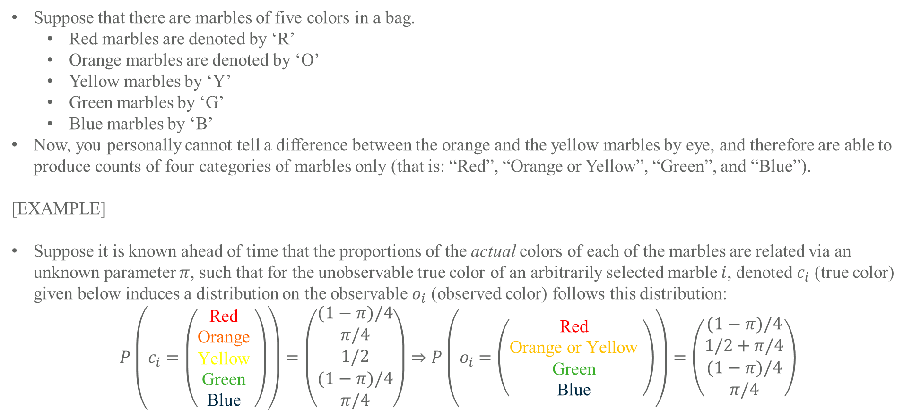
Expectation Maximization (in general) – A Multinomial Example
Suppose that there are marbles of five colors in a bag.
Red marbles are denoted by ‘R’
Orange marbles are denoted by ‘O’
Yellow marbles by ‘Y’
Green marbles by ‘G’
Blue marbles by ‘B’
Now, you personally cannot tell a difference between the orange and the yellow marbles by eye, and therefore are able to produce counts of four categories of marbles only (that is: “Red”, “Orange or Yellow”, “Green”, and “Blue”).
[EXAMPLE]
Suppose it is known ahead of time that the proportions of the actual colors of each of the marbles are related via an unknown parameter $π$, such that for the unobservable true color of an arbitrarily selected marble $i$, denoted $c_{i}$ (true color) given below induces a distribution on the observable $o_{i}$ (observed color) follows this distribution:
$$P\left(c_{i}=\left(\begin{matrix}\text{Red} \\ \text{Orange} \\ \text{Yellow} \\ \text{Green} \\ \text{Blue} \end{matrix}\right)\right)=\left(\begin{matrix}(1−π)/4 \\ π/4 \\ 1/2 \\ (1−π)/4 \\ π/4\end{matrix}\right)⇒P\left(o_{i}=\left(\begin{matrix}\text{Red} \\ \text{Orange} \text{or} \text{Yellow} \\ \text{Green} \\ \text{Blue} \end{matrix}\right)\right)=\left(\begin{matrix}(1−π)/4 \\ 1/2+π/4 \\ (1−π)/4 \\ π/4\end{matrix}\right)$$
Red
Red
Orange
Orange or Yellow
Yellow
Green
Green
Blue
Blue
These Expectation Maximization Notes Draw Heavily from “Maximum Likelihood from Incomplete Data via the EM Algorithm” by Dempster Rubin and Laird (https://www.jstor.org/stable/2984875)

Slide 14
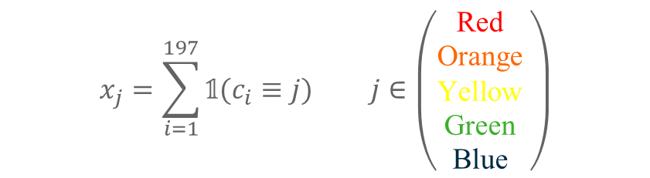
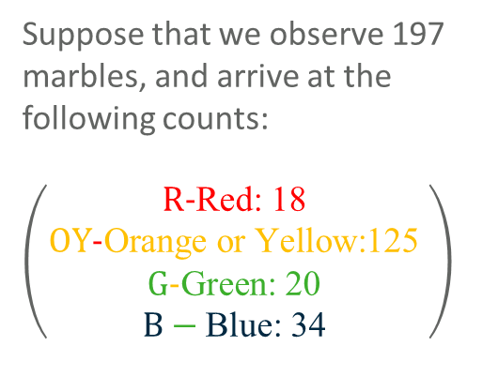
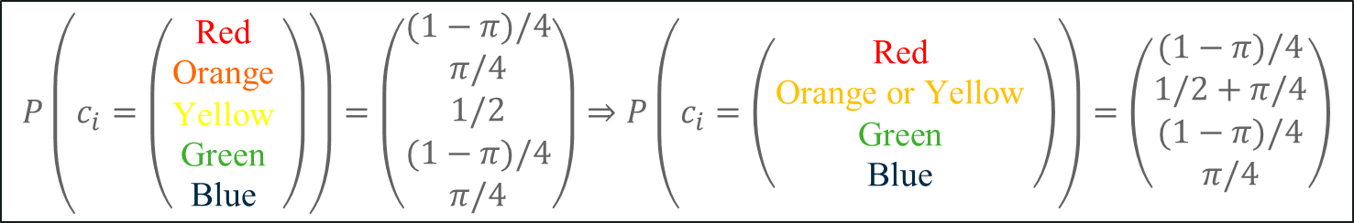
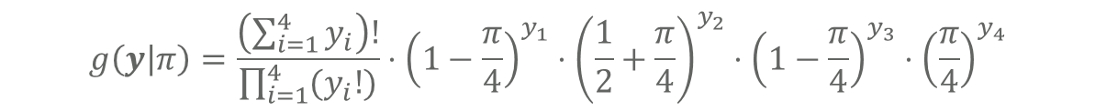
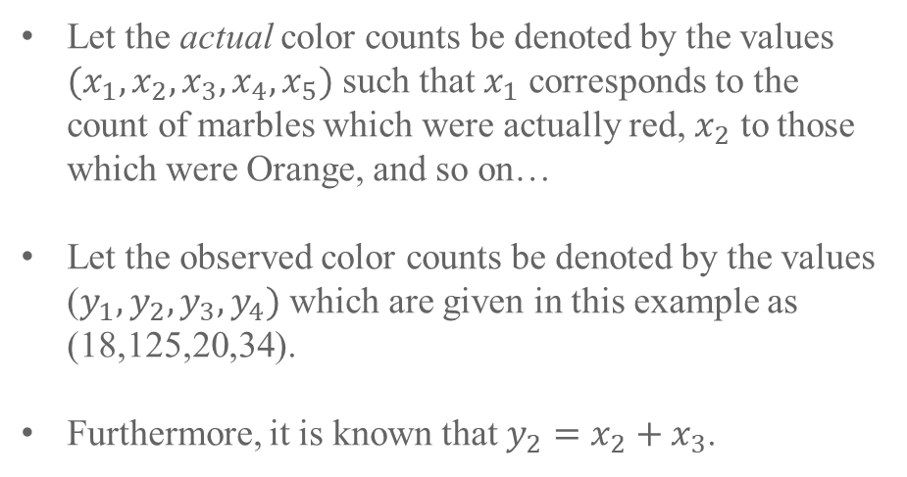
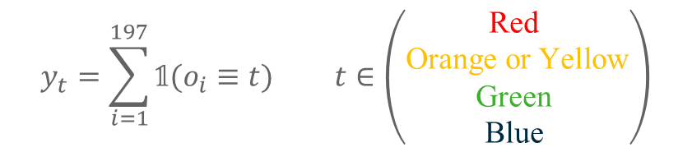
Expectation Maximization (in general) – A Multinomial Example (Continued)
Suppose that we observe 197 marbles, and arrive at the following counts:
$\left(\begin{matrix}\text{R}\text{−}\text{Red}\text{: 18} \\ \text{OY}\text{−}\text{Orange} \text{or} \text{Yellow}\text{:125} \\ \text{G}\text{−}\text{Green}\text{: 20} \\ B−\text{Blue}\text{: 34} \end{matrix}\right)$
$$P\left(c_{i}=\left(\begin{matrix}\text{Red} \\ \text{Orange} \\ \text{Yellow} \\ \text{Green} \\ \text{Blue} \end{matrix}\right)\right)=\left(\begin{matrix}(1−π)/4 \\ π/4 \\ 1/2 \\ (1−π)/4 \\ π/4\end{matrix}\right)⇒P\left(c_{i}=\left(\begin{matrix}\text{Red} \\ \text{Orange} \text{or} \text{Yellow} \\ \text{Green} \\ \text{Blue} \end{matrix}\right)\right)=\left(\begin{matrix}(1−π)/4 \\ 1/2+π/4 \\ (1−π)/4 \\ π/4\end{matrix}\right)$$
$$x_{j}=\sum_{i=1}^{197}{𝟙(c_{i}≡j)} j∈\left(\begin{matrix}\text{Red} \\ \text{Orange} \\ \text{Yellow} \\ \text{Green} \\ \text{Blue} \end{matrix}\right)$$
Let the actual color counts be denoted by the values $(x_{1},x_{2},x_{3},x_{4},x_{5})$ such that $x_{1}$ corresponds to the count of marbles which were actually red, $x_{2}$ to those which were Orange, and so on…
Let the observed color counts be denoted by the values ($y_{1},y_{2},y_{3},y_{4})$ which are given in this example as (18,125,20,34).
Furthermore, it is known that $y_{2}=x_{2}+x_{3}$.
$$y_{t}=\sum_{i=1}^{197}{𝟙(o_{i}≡t)} t∈\left(\begin{matrix}\text{Red} \\ \text{Orange} \text{or} \text{Yellow} \\ \text{Green} \\ \text{Blue} \end{matrix}\right)$$
The Likelihood on $π$ for the full data can be expressed as:
$$f\left(x | π\right)=\frac{\left(\sum_{i=1}^{5}{x_{i}}\right)!}{\prod_{i=1}^{5}{{(x}_{i}!)}}⋅{\left(\frac{1−π}{4}\right)}^{x_{1}}⋅{\left(\frac{π}{4}\right)}^{x_{2}}⋅{\left(\frac{1}{2}\right)}^{x_{3}}⋅{\left(\frac{1−π}{4}\right)}^{x_{4}}⋅{\left(\frac{π}{4}\right)}^{x_{5}}$$
The coarsened/incomplete Likelihood on $π$ for the full data can be expressed as:
$$g\left(y | π\right)=\frac{\left(\sum_{i=1}^{4}{y_{i}}\right)!}{\prod_{i=1}^{4}{{(y}_{i}!)}}⋅{\left(1−\frac{π}{4}\right)}^{y_{1}}⋅{\left(\frac{1}{2}+\frac{π}{4}\right)}^{y_{2}}⋅{\left(1−\frac{π}{4}\right)}^{y_{3}}⋅{\left(\frac{π}{4}\right)}^{y_{4}}$$
DLR77 (https://www.jstor.org/stable/2984875)

Slide 15
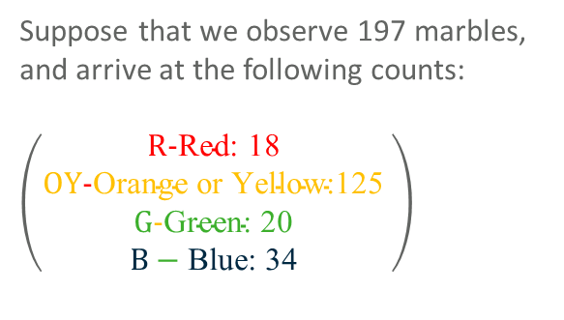
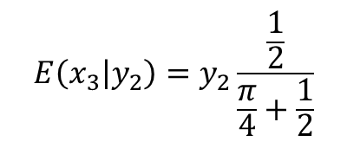
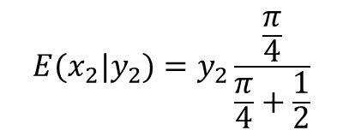


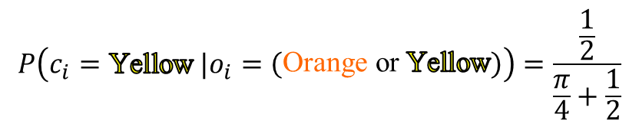
Expectation Maximization (in general) – A Multinomial Example (E-Step)
Clearly, due to the fact that a marble cannot actually be two colors simultaneously, there is no probability that any marble is truly both orange and yellow at the same time, therefore we may express the probability that a marble is orange or yellow as follows:
$$P\left(o_{i}=\left(\begin{matrix}\text{Orange} \text{or} \text{Yellow}\end{matrix}\right)\right)=P\left(c_{i}∈\left(\begin{matrix}\text{Orange} \\ \text{Yellow}\end{matrix}\right)\right)=P\left(c_{i}=\text{Orange}\right)+P\left(c_{i}=\text{Yellow}\right)−P\left(c_{i}=\text{Yellow} \&{ c}_{i}=\text{Orange}\right)$$
$$=\frac{π}{4}+\frac{1}{2}$$
$$=P\left(c_{i}=\text{Orange}\right)+P\left(c_{i}=\text{Yellow}\right)−0$$
From here we can derive the expression for the maximum likelihood estimates of the unobserved counts for orange and yellow marbles ${(x}_{2},x_{3})$ in terms of the observed count of “orange or yellow” marbles ($y_{2}$).
$P\left(c_{i}=\text{Orange} |o_{i}=\left(\begin{matrix}\text{Orange} \text{or} \text{Yellow}\end{matrix}\right)\right)=\frac{P\left(o_{i}=\left(\begin{matrix}\text{Orange} \text{or} \text{Yellow}\end{matrix}\right) \&{ c}_{i}=\text{Orange}\right)}{P(o_{i}=\left(\begin{matrix}\text{Orange} \text{or} \text{Yellow}\end{matrix}\right))}=\frac{P(c_{i}=\text{Orange}\text{)}}{P\left(o_{i}=\left(\begin{matrix}\text{Orange} \text{or} \text{Yellow}\end{matrix}\right)\right) }=\frac{\frac{π}{4}}{\frac{π}{4}+\frac{1}{2}}$
$$P\left(c_{i}=\text{Yellow} |o_{i}=\left(\begin{matrix}\text{Orange} \text{or} \text{Yellow}\end{matrix}\right)\right)=\frac{\frac{1}{2}}{\frac{π}{4}+\frac{1}{2}}$$
Therefore the conditional expectation of $x_{2}$ and $x_{3}$ are:
$$E(x_{2}|y_{2})=y_{2}\frac{\frac{π}{4}}{\frac{π}{4}+\frac{1}{2}}$$
$$E\left(x_{3} | y_{2}\right)=y_{2}\frac{\frac{1}{2}}{\frac{π}{4}+\frac{1}{2}}$$
Suppose that we observe 197 marbles, and arrive at the following counts:
$\left(\begin{matrix}\text{R}\text{−}\text{Red}\text{: 18 } \\ \text{OY}\text{−}\text{Orange} \text{or} \text{Yellow}\text{:125 } \\ \text{G}\text{−}\text{Green}\text{: 20 } \\ B−\text{Blue}\text{: 34 }\end{matrix}\right)$
- and -
These Expectation Maximization Notes Draw Heavily from “Maximum Likelihood from Incomplete Data via the EM Algorithm” by Dempster Rubin and Laird (https://www.jstor.org/stable/2984875)

Slide 16
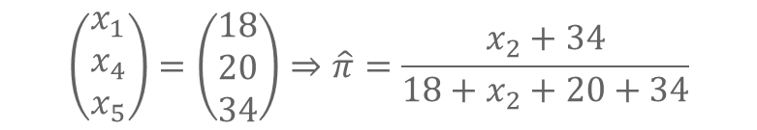
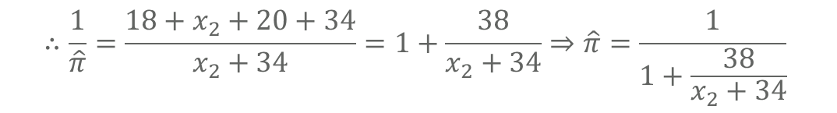
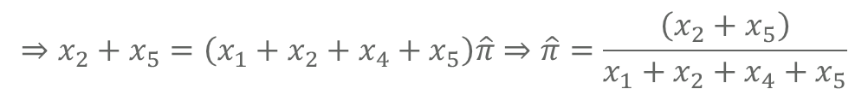
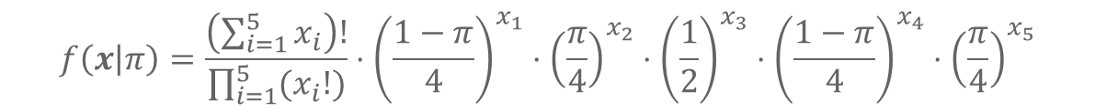
Expectation Maximization (in general) – A Multinomial Example (M-Step)
$$⇒x_{1}+x_{4}=x_{2}\hat{π}+x_{5}\hat{π}+x_{1}\hat{π}+x_{4}\hat{π}$$
Recall that the full likelihood for the multinomial distribution was given by:
$$f\left(x | π\right)=\frac{\left(\sum_{i=1}^{5}{x_{i}}\right)!}{\prod_{i=1}^{5}{{(x}_{i}!)}}⋅{\left(\frac{1−π}{4}\right)}^{x_{1}}⋅{\left(\frac{π}{4}\right)}^{x_{2}}⋅{\left(\frac{1}{2}\right)}^{x_{3}}⋅{\left(\frac{1−π}{4}\right)}^{x_{4}}⋅{\left(\frac{π}{4}\right)}^{x_{5}}$$
$$⇒\log{L(π|x)}=\log{\frac{\left(\sum_{i=1}^{5}{x_{i}}\right)!}{\prod_{i=1}^{5}{{(x}_{i}!)}}}+x_{1}\log\left(\frac{\left(1−π\right)}{4}\right)+x_{2}\log\left(\frac{π}{4}\right)+x_{3}\log\left(\frac{1}{2}\right)+x_{4}\log\left(\frac{\left(1−π\right)}{4}\right)+x_{5}\log\left(\frac{π}{4}\right)$$
In this example, only $x_{2}$ and $x_{3}$ are unobservable, the rest are known:
$$⇒\frac{∂\log{L(π|x)}}{∂ π}=x_{1}\left(\frac{4}{1−π}\right)\left(−\frac{1}{4}\right)+x_{2}\left(\frac{4}{π}\right)\left(\frac{1}{4}\right)+x_{4}\left(\frac{4}{1−π}\right)\left(−\frac{1}{4}\right)+x_{5}\left(\frac{4}{π}\right)\left(\frac{1}{4}\right)=\frac{x_{1}}{π−1}+\frac{x_{2}}{π}+\frac{x_{4}}{π−1}+\frac{x_{5}}{π}$$
$$⇒\frac{x_{1}}{\hat{π}−1}+\frac{x_{2}}{\hat{π}}+\frac{x_{4}}{\hat{π}−1}+\frac{x_{5}}{\hat{π}}=0⇒\left(x_{2}+x_{5}\right)\left(1−\hat{π}\right)=\left(x_{1}+x_{4}\right)\hat{π}⇒x_{2}+x_{5}−x_{2}\hat{π}−x_{5}\hat{π}=x_{1}\hat{π}+x_{4}\hat{π}$$
$$⇒x_{2}+x_{5}=\left(x_{1}+x_{2}+x_{4}+x_{5}\right)\hat{π}⇒\hat{π}=\frac{\left(x_{2}+x_{5}\right)}{x_{1}+x_{2}+x_{4}+x_{5}}$$
Suppose that we observe 197 marbles, and arrive at the following counts:
$\left(\begin{matrix}\text{R}\text{−}\text{Red}\text{: 18 } \\ \text{OY}\text{−}\text{Orange} \text{or} \text{Yellow}\text{:125 } \\ \text{G}\text{−}\text{Green}\text{: 20 } \\ B−\text{Blue}\text{: 34 }\end{matrix}\right)$
$$⇒−x_{1}\hat{π}−x_{4}\hat{π}+x_{1}+x_{4}=x_{2}\hat{π}+x_{5}\hat{π}$$
$$\left(\begin{matrix}x_{1} \\ x_{4} \\ x_{5}\end{matrix}\right)=\left(\begin{matrix}18 \\ 20 \\ 34\end{matrix}\right)⇒\hat{π}=\frac{x_{2}+34}{18+x_{2}+20+34}$$
$$⇒x_{1}+x_{4}=x_{2}\hat{π}+x_{5}\hat{π}+x_{1}\hat{π}+x_{4}\hat{π}$$
$$∴\frac{1}{\hat{π}}=\frac{18+x_{2}+20+34}{x_{2}+34}=1+\frac{38}{x_{2}+34}⇒\hat{π}=\frac{1}{1+\frac{38}{x_{2}+34}}$$

Slide 17
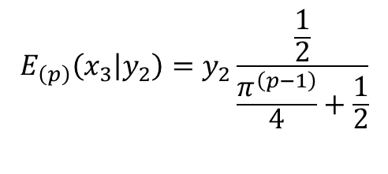

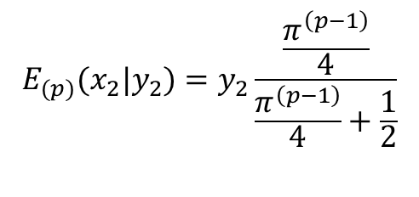

Expectation Maximization (in general) – A Multinomial Example (Iteration)
Taking the conditional expectations for the computation of $x_{2}$ and $x_{3}$ will depend on a particular estimation of $π$, an initial estimate ($π^{\left(0\right)}$) must be supplied to the algorithm to start the procedure, then conditional expectations for the missing (coarsened) data at the $p$^{th} step (where $p∈ \{1,2,…\}$) is given by:
$$E_{(p)}(x_{2}|y_{2})=y_{2}\frac{\frac{π^{\left(p−1\right)}}{4}}{\frac{π^{\left(p−1\right)}}{4}+\frac{1}{2}}$$
$$E_{\left(p\right)}\left(x_{3} | y_{2}\right)=y_{2}\frac{\frac{1}{2}}{\frac{π^{\left(p−1\right)}}{4}+\frac{1}{2}}$$
[E – Step]
- and -
$$\hat{π^{\left(p\right)}}=\frac{1}{1+\frac{38}{E_{(p)}(x_{2}|y_{2})+34}}$$
[M – Step]
Convergence Criteria:
Generally we use relative convergence criteria (when the change in the parameters from step $p$ to step $p+1$ falls below a relative tolerance $ε_{R}$) to determine when to stop iterating, for instance, the iteration will continue until:
$${\left(\frac{1}{1+\frac{38}{E_{\left(p\right)}\left(x_{2} | y_{2}\right)+34}}−\frac{1}{1+\frac{38}{E_{\left(p−1\right)}\left(x_{2} | y_{2}\right)+34}}\right)}^{2}≤ε_{R}$$
[Convergence]

Slide 18
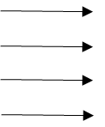













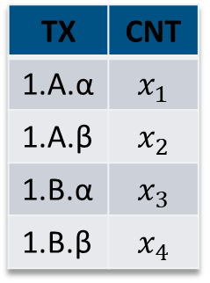









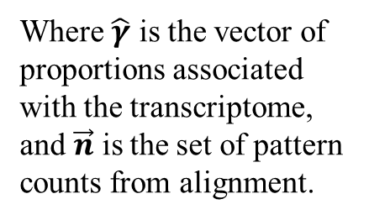
Expectation Maximization (Genetic Abundance Estimation)
We observe $N_{r}$ RNA-seq reads from an experiment involving a transcriptome of size $T$.
Each of the $N_{r}$ reads came specifically from only one of the $T$ categories.
True Abundances
In-Vivo RNA
Aligned Reads allow counts of compatible transcript patterns to be captured.
Gene 1
TX | CNT
1.A.α | $$x_{1}$$
1.A.β | $$x_{2}$$
1.B.α | $$x_{3}$$
1.B.β | $$x_{4}$$
Transcript A
Sampled RNA
Allele $α$
Pseudo/Quasi/Fully Aligned RNA Read Pattern Counts
Allele $β$
1.a.α
1.b.α
$$n_{1aα}$$
$$n_{1bα}$$
Transcript B
1.a.β
$$n_{1a⋅}$$
$$n_{1⋅α}$$
$$n_{1b⋅}$$
1.b.β
Allele $α$
RNA reads are sampled from the original subject’s genetic material.
Allele $β$
$$n_{1bβ}$$
$$n_{1aβ}$$
We are interested in the vector of true abundances, and estimate these through EM.
$$…$$
Gene 2
Expectation Maximization
$$n_{⋅⋅⋅}$$
$$n_{1b⋅1aα}$$
$$…$$
$$n_{1a⋅1bα}$$
$$n_{1bα1aβ}$$
$$n_{1⋅β}$$
$$n_{1bβ1aα}$$
Genes, transcripts, and alleles are initially differentially expressed in a subject of interest.
[E-Step] $E\left(\vec{x} \right|\vec{ n})$
[M-Step] $\frac{∂L\left(\hat{γ} | \vec{x}\right)}{∂\hat{γ}}=0$
$$n_{1b⋅1aβ}$$
$$n_{1a⋅1bβ}$$
Where $\hat{γ}$ is the vector of proportions associated with the transcriptome, and $\vec{n}$ is the set of pattern counts from alignment.

Slide 19
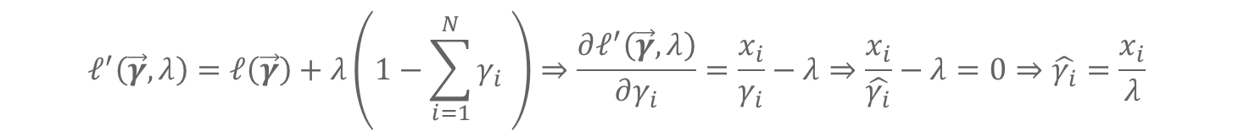
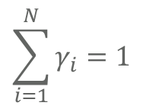
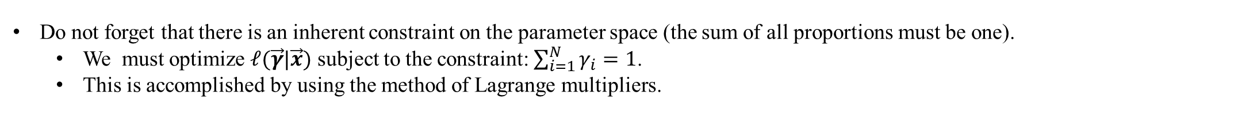
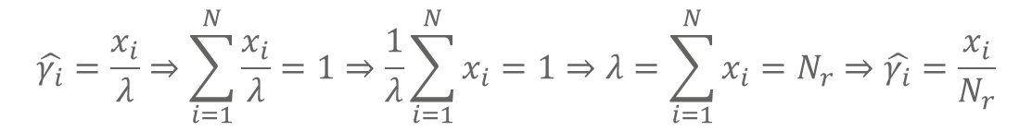
Expectation Maximization (Genetic Abundance Estimation) [M-Step]
Clearly, the distribution of the reads among their true transcript sources can be modeled as multinomial.
The probability distribution of the count vector of the true abundances, $\vec{X}$, is
$$\operatorname{Pr}\left(\vec{X}=\vec{x}\right)=\frac{\left(\sum_{i=1}^{N}{x_{i}}\right)!}{\prod_{i=1}^{N}{\left(x_{i}\right)!}}\prod_{i=1}^{N}{γ_{i}^{x_{i}}}$$
This probability distribution function doubles as the Likelihood for the parameter vector $\vec{γ}$ under the observed data $\vec{x}$.
$$L\left(\vec{γ} | \vec{x}\right)=\frac{\left(\sum_{i=1}^{N}{x_{i}}\right)!}{\prod_{i=1}^{N}{\left(x_{i}\right)!}}\prod_{i=1}^{N}{γ_{i}^{x_{i}}}⇒ℓ\left(\vec{γ} | \vec{x}\right)=\log{\frac{\left(\sum_{i=1}^{N}{x_{i}}\right)!}{\prod_{i=1}^{N}{\left(x_{i}\right)!}}}+\sum_{i=1}^{N}{x_{i}}\log{γ_{i}}⇒\frac{∂ℓ\left(\vec{γ} | \vec{x}\right)}{∂γ_{i}}=\frac{x_{i}}{γ_{i}}$$
$$\sum_{i=1}^{N}{γ_{i}}=1$$
Do not forget that there is an inherent constraint on the parameter space (the sum of all proportions must be one).
We must optimize $ℓ(\vec{γ}|\vec{x})$ subject to the constraint: $\sum_{i=1}^{N}{γ_{i}}=1$.
This is accomplished by using the method of Lagrange multipliers.
$$ℓ^{′}\left(\vec{γ},λ\right)=ℓ\left(\vec{γ}\right)+λ\left(1−\sum_{i=1}^{N}{γ_{i} }\right)⇒\frac{∂ℓ^{′}\left(\vec{γ},λ\right)}{∂γ_{i}}=\frac{x_{i}}{γ_{i}}−λ⇒\frac{x_{i}}{\hat{γ_{i}}}−λ=0⇒\hat{γ_{i}}=\frac{x_{i}}{λ}$$
$$\hat{γ_{i}}=\frac{x_{i}}{λ}⇒\sum_{i=1}^{N}{\frac{x_{i}}{λ}}=1⇒\frac{1}{λ}\sum_{i=1}^{N}{x_{i}}=1⇒λ=\sum_{i=1}^{N}{x_{i}}=N_{r}⇒\hat{γ_{i}}=\frac{x_{i}}{N_{r}}$$

Slide 20
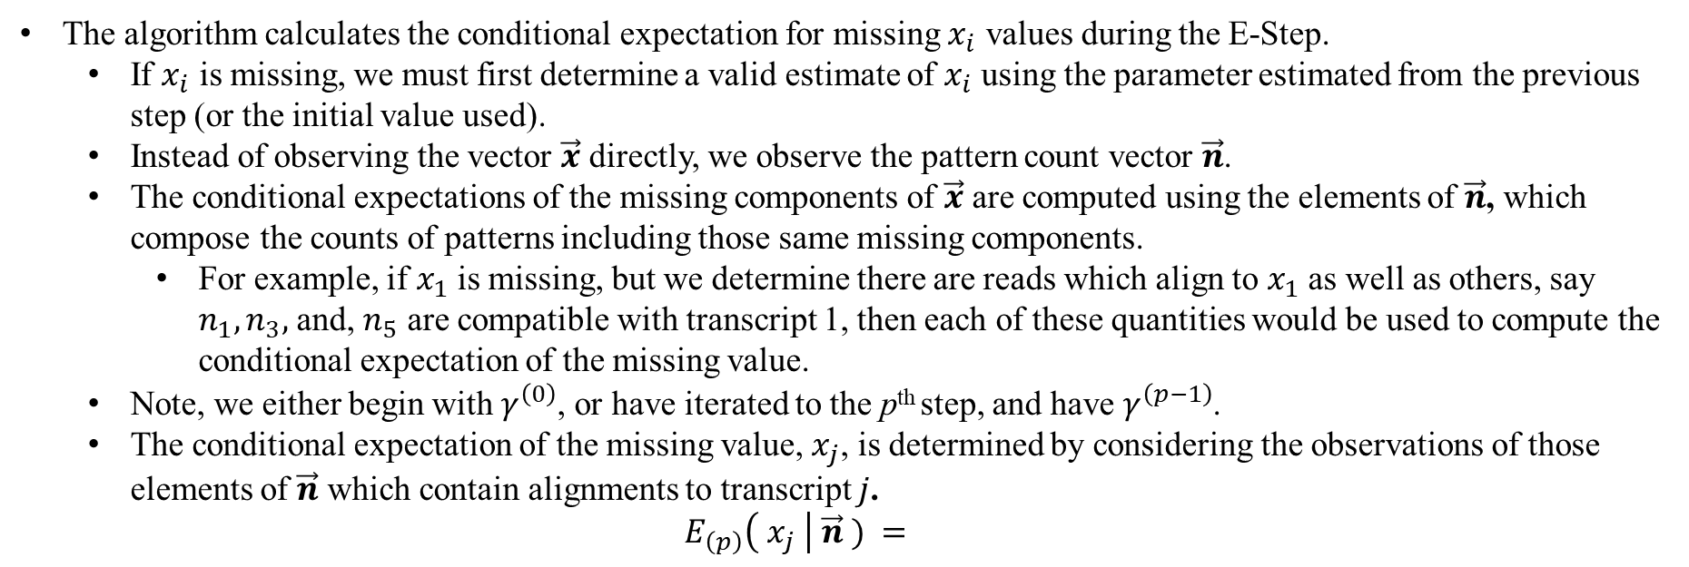
Expectation Maximization (Genetic Abundance Estimation) [E-Step]
The algorithm calculates the conditional expectation for missing $x_{i}$ values during the E-Step.
If $x_{i}$ is missing, we must first determine a valid estimate of $x_{i}$ using the parameter estimated from the previous step (or the initial value used).
Instead of observing the vector $\vec{x}$ directly, we observe the pattern count vector $\vec{n}$.
The conditional expectations of the missing components of $\vec{x}$ are computed using the elements of $\vec{n}$, which compose the counts of patterns including those same missing components.
For example, if $x_{1}$ is missing, but we determine there are reads which align to $x_{1}$ as well as others, say $n_{1},n_{3},$ and, $n_{5}$ are compatible with transcript 1, then each of these quantities would be used to compute the conditional expectation of the missing value.
Note, we either begin with $γ^{\left(0\right)}$, or have iterated to the p^{th} step, and have $γ^{\left(p−1\right)}$.
The conditional expectation of the missing value, $x_{j}$, is determined by considering the observations of those elements of $\vec{n}$ which contain alignments to transcript $j$.
$$E_{\left(p\right)}\left( x_{j} \right| \vec{n} ) =$$

